Slide 1
ATL Academy
Spring boot MVC (Thymleaf)

Slide 2
Dependencies
<dependency>
<groupId>org.springframework.boot</groupId>
<artifactId>spring-boot-starter-thymeleaf</artifactId>
</dependency>

Slide 3
Properties files
spring.thymeleaf.template-loader-path: classpath:/templates
spring.thymeleaf.suffix: .html
spring.thymeleaf.cache: false

Slide 4
View Template
<!DOCTYPE html>
<html lang="en” xmlns:th="http://www.thymeleaf.org">
<head>
<meta charset="UTF-8">
<title th:text="'Hello, ' + ${name} + '!'">Hello Anar</title>
<link href="/css/main.css" rel="stylesheet">
</head>

Slide 5
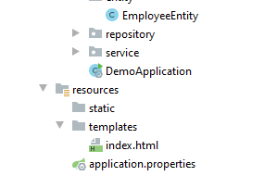
View file structure
Every html file will be inside of templates folder

Slide 6
Using Texts
@GetMapping({"/", "/hello"})
public String hello(Model model, @RequestParam(value="name", required=false, defaultValue="World") String name)
{
model.addAttribute("name", name);
return "hello";
}
<h2 class="hello-title“ th:text="'Hello, ' + ${name} + '!'"></h2>

Slide 7
Standard Expression Syntax Simple expressions
Variable Expressions: ${...}
Selection Variable Expressions: *{...}
Message Expressions: #{...}
Link URL Expressions: @{...}

Slide 8
literals
Text literals: 'one text', 'Another one!',…
Number literals: 0, 34, 3.0, 12.3,…
Boolean literals: true, false
Null literal: null
Literal tokens: one, sometext, main,…

Slide 9
Text operations
String concatenation: +
Literal substitutions: |The name is ${name}|

Slide 10
Arithmetic operations:
Binary operators: +, -, *, /, %
Minus sign (unary operator): -

Slide 11
Boolean operations:
Binary operators: and, or
Boolean negation (unary operator): !, not

Slide 12
Comparisons and equality
Comparators: >, <, >=, <= (gt, lt, ge, le)
Equality operators: ==, != (eq, ne)

Slide 13
Conditional operators:
If-then: (if) ? (then)
If-then-else: (if) ? (then) : (else)
Default: (value) ?: (defaultvalue)

Slide 14
Collection Attributes
List<Student> students = new ArrayList<Student>();
// logic to build student
datamodel.addAttribute("students1", students);
<tbody>
<tr th:each="student: ${students1}">
<td th:text="${student.id}" />
<td th:text="${student.name}" />
</tr>
</tbody>

Slide 15
Conditional Evaluation
<td>
<span th:if="${student.gender} == 'M'" th:text="Male" />
<span th:unless="${student.gender} == 'M'“ th:text="Female" />
</td>

Slide 16
switch and case
<td th:switch="${student.gender}">
<span th:case="'M'" th:text="Male" />
<span th:case="'F'" th:text="Female" />
</td>

Slide 17
Handling User Input (Form)
<form action="#" th:action="@{/saveStudent}" th:object="${student}" method="post">
<table border="1">
<tr>
<td><label th:text="#{msg.id}" /></td>
<td><input type="number" th:field="*{id}" /></td>
</tr>
<tr>
<td><label th:text="#{msg.name}" /></td>
<td><input type="text" th:field="*{name}" /></td>
</tr>
<tr>
<td><input type="submit" value="Submit" /></td>
</tr>
</table>
</form>
@Controllerpublic
class StudentController {
@RequestMapping(value = "/saveStudent", method = RequestMethod.POST) public String saveStudent(@ModelAttribute Student student,
BindingResult errors,
Model model) {
// logic to process input data
}}

Slide 18
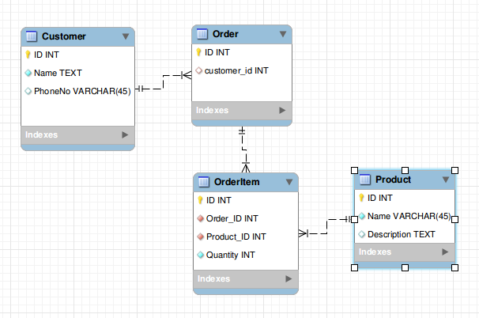
Home work

Slide 19
Link and refernces
https://www.thymeleaf.org/doc/tutorials/2.1/usingthymeleaf.html
https://hellokoding.com/spring-boot/thymeleaf/

